Slide 1
CENG401 MACHINE LEARNING AND ARTIFICIAL INTELLIGENCE
WEEK-6
MARKOV DESICION PROCESS
Asst.Prof.Dr. Murat ŞİMŞEK

Slide 2
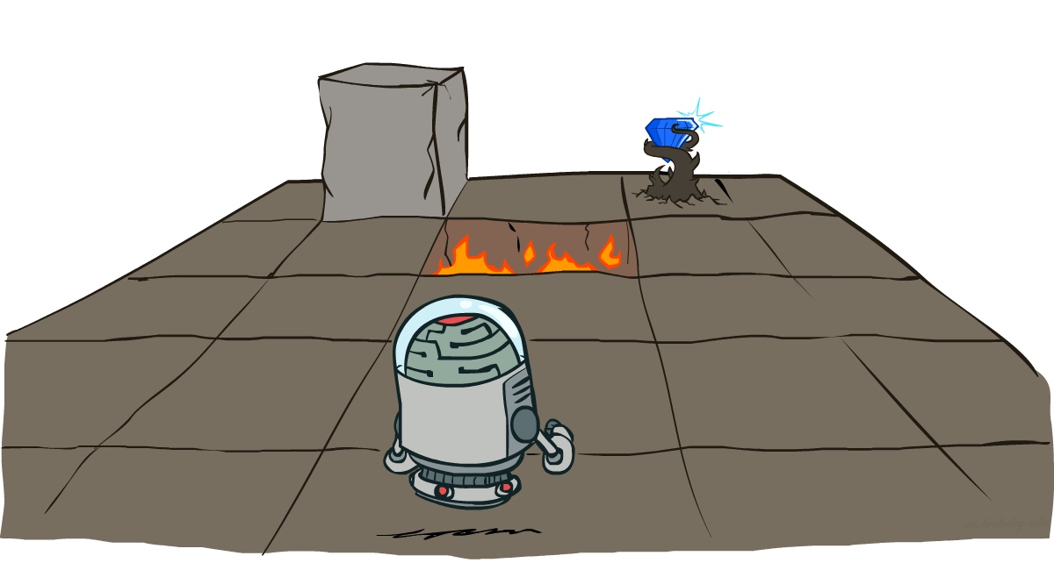
Markov Decision Processes
Notes:
Intelligent agents are supposed to maximize their performance measure.

Slide 3
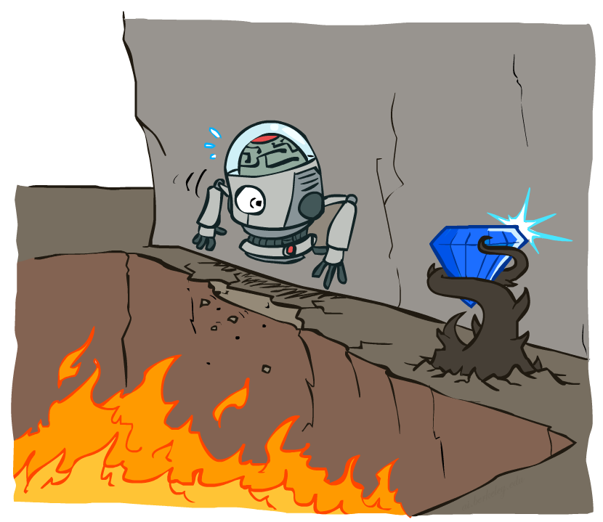
Non-Deterministic Search
Markov decision process (MDP) provides a mathematical framework for modeling decision making in situations where outcomes are partly random and partly under the control of a decision maker.
Notes:
MDP, bir karar alıcının belirli bir çevre ile etkileşimde bulunduğu ve bu etkileşim sırasında kararlar alması gereken durumları modeller.

Slide 4
Solution
Before even starting with MDPs, quickly glance through the terminology:
Policy: A policy is the thought process behind picking an action. In practice, it is a probability distribution assigned to the set of actions. Highly rewarding actions will have a high probability and vice versa.
Environment
Agent
State
Action
Policy

Slide 5





Example: Grid World
A maze-like problem
The agent lives in a grid
Walls block the agent’s path
80% of the time, the action North takes the agent North (if there is no wall there)
10% of the time, North takes the agent West; 10% East
If there is a wall in the direction the agent would have been taken, the agent stays put
The agent receives rewards each time step
Small “living” reward each step
Big rewards come at the end
Goal: maximize sum of rewards

Slide 6

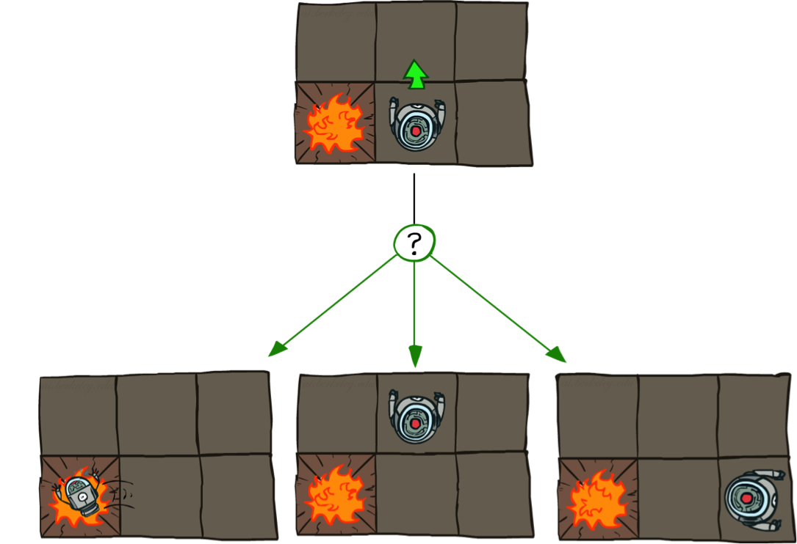
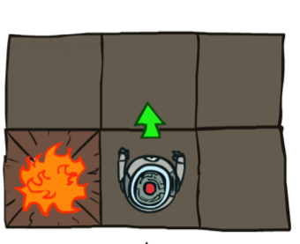
Grid World Actions
Deterministic Grid World
Stochastic Grid World

Slide 7
Markov Decision Processes
An MDP is defined by:
A set of states s ∈ S
A set of actions a ∈ A
A transition function T(s, a, s’)
Probability that a from s leads to s’, i.e., P(s’| s, a)
Also called the model or the dynamics
A reward function R(s, a, s’)
Sometimes just R(s) or R(s’)
A start state
Maybe a terminal state
MDPs are non-deterministic search problems
One way to solve them is with expectimax search
We’ll have a new tool soon
Notes:
In search problems: did not talk about actions, but about successor functions --- now the information inside the successor function is unpacked into actions, transitions and reward
Write out S, A, example entry in T, entry in R
Reward function different from the book : R(s,a,s’)
In book simpler for equations, but not useful for the projects.
Need to modify expectimax a tiny little bit to account for rewards along the way, but that’s something you should be able to do, and so you can already solve MDP’s (not in most efficient way)

Slide 8
Markov Decision Processes
Defined as a tuple: <S, A, P, R>
S: State
A: Action
P: Transition function
Table P(s’| s, a), prob of s’ given action “a” in state “s”
R: Reward
R(s, a) = cost or reward of taking action a in state s
Choose a sequence of actions (not just one decision or one action)
Utility based on a sequence of decisions
Notes:
In search problems: did not talk about actions, but about successor functions --- now the information inside the successor function is unpacked into actions, transitions and reward
Write out S, A, example entry in T, entry in R
Reward function different from the book : R(s,a,s’)
In book simpler for equations, but not useful for the projects.
Need to modify expectimax a tiny little bit to account for rewards along the way, but that’s something you should be able to do, and so you can already solve MDP’s (not in most efficient way)

Slide 9


What is Markov about MDPs?
“Markov” generally means that given the present state, the future and the past are independent
For Markov decision processes, “Markov” means action outcomes depend only on the current state
This is just like search, where the successor function could only depend on the current state (not the history)
Andrey Markov (1856-1922)
Notes:
Like search: successor function only depended on current state
Can make this happen by stuffing more into the state;
Very similar to search problems: when solving a maze with food pellets, we stored which food pellets were eaten

Slide 10

Example
What SEQUENCE of actions should our agent take?
Reward
+1
1
Each action costs –1/25
Agent can take action N, E, S, W
Faces uncertainty in every state
N
0.8
Blocked
CELL
Reward
-1
2
0.1
0.1
3
1
2
3
4
Start

Slide 11
Solution
S: State of the agent on the grid (4,3)
Note that cell denoted by (x,y)
A: Actions of the agent, i.e., N, E, S, W
P: Transition function
Table P(s’| s, a), prob of s’ given action “a” in state “s”
E.g., P( (4,3) | (3,3), N) = 0.1
E.g., P((3, 2) | (3,3), N) = 0.8
(Robot movement, uncertainty of another agent’s actions,…)
R: Reward (more comments on the reward function later)
R( (3, 3), N) = -1/25
R (4,1) = +1

Slide 12
End of the Week…

